Slide 1
PROJECT DEVELOPMENT PHASE DEVELOPMENT OF SPRINT-02
DATE | 31ST OCTOBER 2022
TEAM ID | PNT2022TMID30005
PROJECT TITLE | ANALYSIS OF CROP YIELD PREDICTION USING DATA TECHNIQUE

Slide 2
SPRINT -01
DATA COLLECTION
DATA PREPARATION
SPRINT-02
* DATA EXPLORATION
SPRINT-03
* DASHBOARD CREATION
SPRINT-04
REPORT CREATION
STORY CREATION

Slide 3
DEVELOPMENT OF SPRINT-02

Slide 4
DATA EXPLORATION:
Dataset collection
The dataset used for this project is collected from various online sources like Kaggle.com and data.govt.in. We have taken the agricultural data of four regions namely, Mangalore, Hasana, Kodagu and Kasaragod.
Some important features or the parameters which has the highest impact on the agricultural yield considered in the project are listed below.
*Rainfall (in mm)
* Humidity
*Temperature
* Area
* Yield
*Type of the soil
* Location
* Price

Slide 5
Pre-processing the data After the selection of the dataset, it has to be pre-processed into a form that you can work with. Some of the steps are formatting, cleaning and sampling. Initially the data you have selected is converted into the format suitable for you to work with. Cleaning data is the removal or fixing of the mixed data. Sampling is taking a small representative sample of the selected data that may be much faster for exploring the solutions than datasets.
Transforming the data
The final step is transforming the selected data. The preprocessed data here is then transformed into data that is ready for machine learning algorithms by using various engineering features like scaling, feature aggregation and so on. There may be several features that can be combined into a single feature which would be more meaningful to the problem you are trying to solve. Figure 1 below shows the final data to be used by the classifiers. Figures 2 and 3 shows the system design of the proposed system.

Slide 6
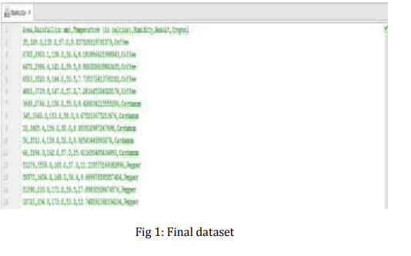
FIGURE-01
FINAL DATASET

Slide 7
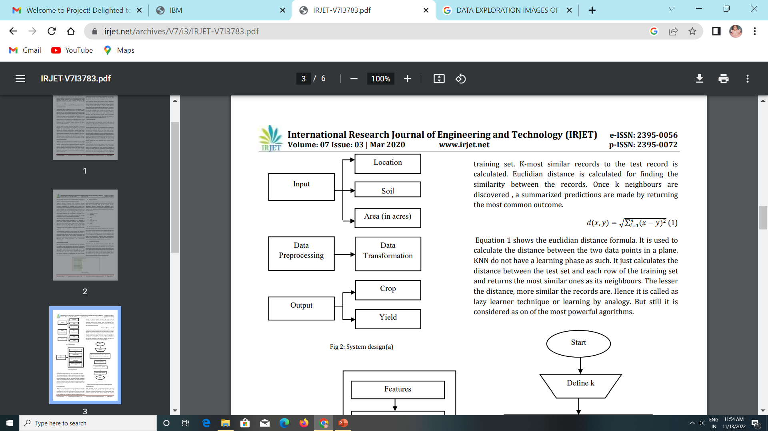
FIGURE-02(SYSTEM DESIGN [a])

Slide 8
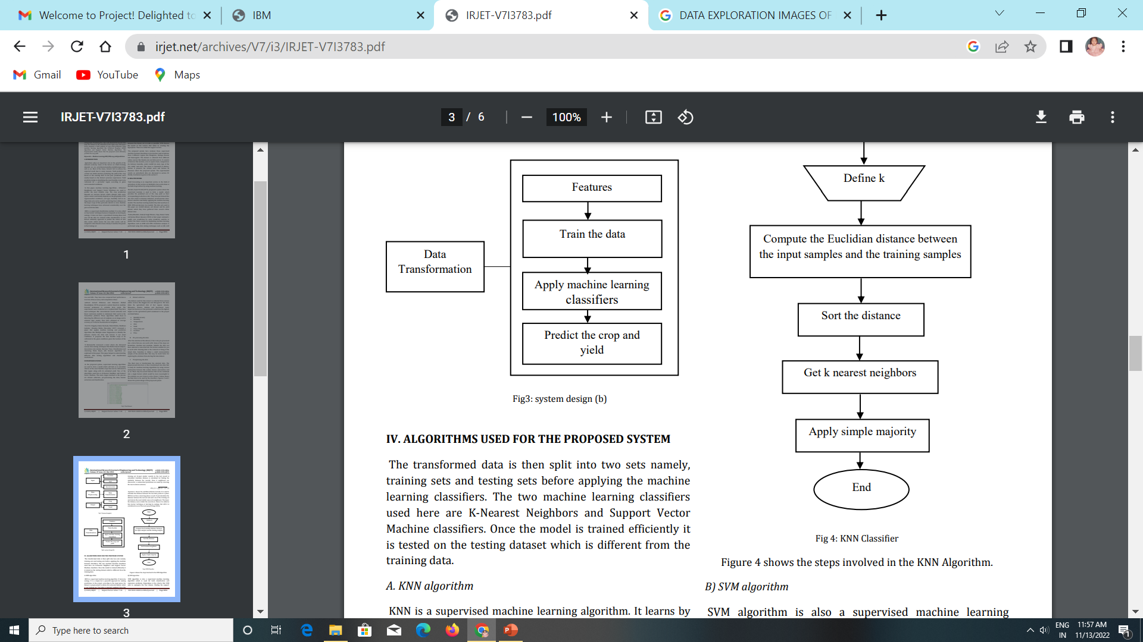
FIGURE-03(SYSTEM DESIGN [b])
APPLY CLASSIFIERS

Slide 9
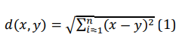
ALGORITHMS USED FOR THE PROPOSED SYSTEM
KNN algorithm KNN is a supervised machine learning algorithm. It learns by analogy. It is a simple but a powerful approach for making predictions. In the project, according to the input given, the dataset is preprocessed to obtain the extracted dataset which is our training set. Test data is selected randomly from this training set. K-most similar records to the test record is calculated. Euclidian distance is calculated for finding the similarity between the records. Once k neighbours are discovered , a summarized predictions are made by returning the most common outcome.
Equation 1 shows the euclidian distance formula. It is used to calculate the distance between the two data points in a plane. KNN do not have a learning phase as such. It just calculates the distance between the test set and each row of the training set and returns the most similar ones as its neighbours. The lesser the distance, more similar the records are. Hence it is called as lazy learner technique or learning by analogy. But still it is considered as on of the most powerful agorithms.

Slide 10
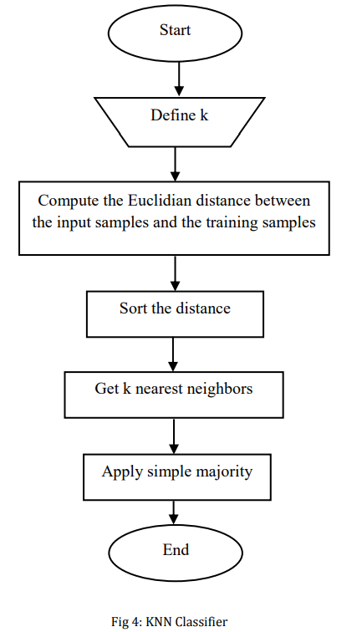
KNN ALGORITHMS

Slide 11
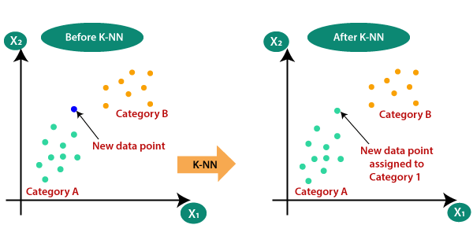
K-NN DIAGRAM

Slide 12

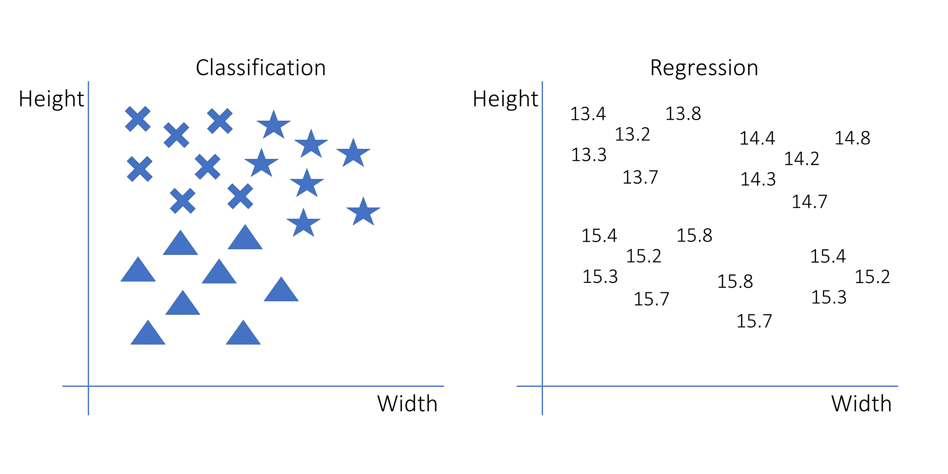

Slide 13
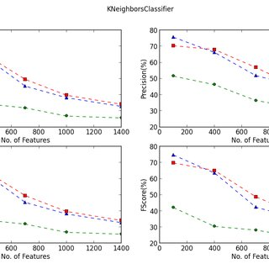
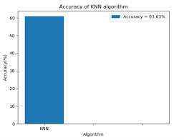
ACCURACY OF DATA’S

Slide 14
